Slide 1
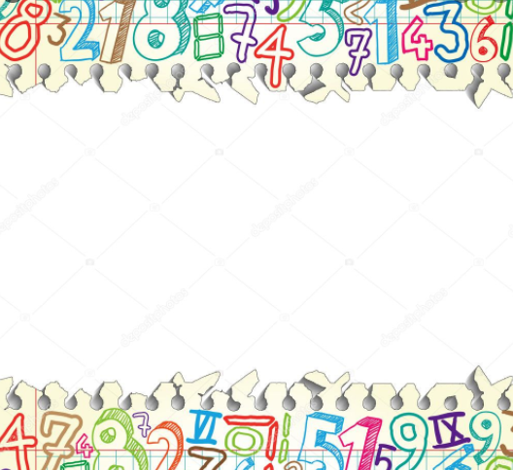
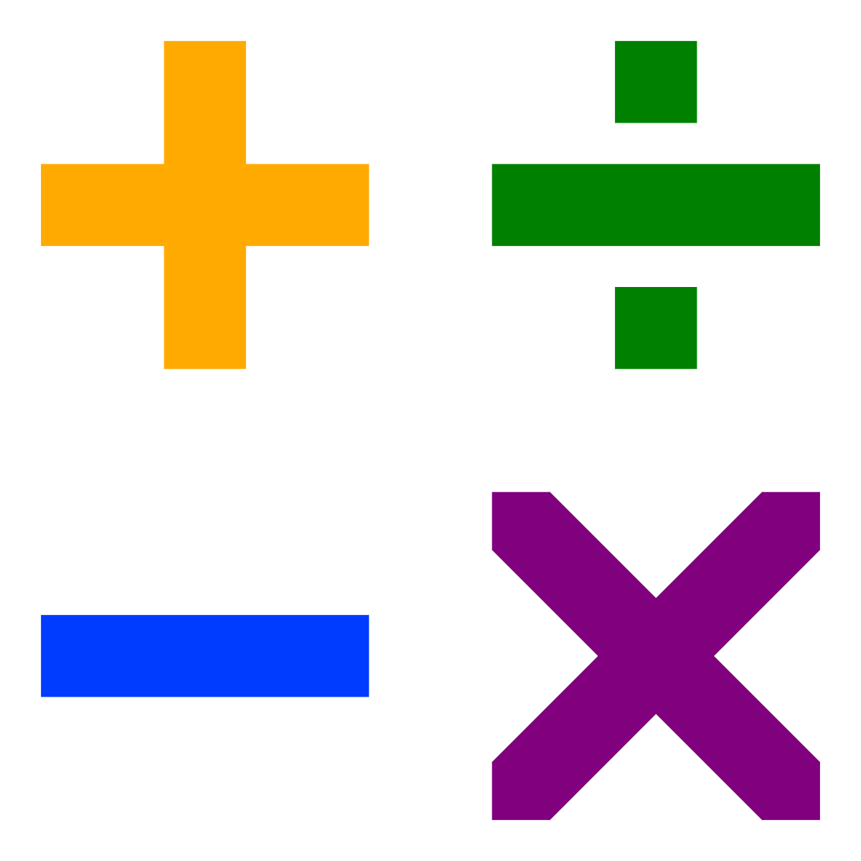

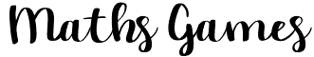


Maths baseball
Divide your class into two teams to play math baseball
One team will start at bat, scoring runs by choosing questions worth one, two or three bases. You’ll “pitch” the questions, which range in difficulty depending on how many bases they’re worth. If the at-bat team answers incorrectly, the defending team can respond correctly to earn an out. After three outs, switch sides. Play until one team hits 10 runs.
BINGO
First, create bingo cards that contain answers to different multiplication tables. Second, hand them out to students and make sure they have a separate sheet for calculations. Finally, instead of calling numbers, state equations such as 8 × 7. After determining the product is 56, they can check off the number if it’s on their cards.
Round the block
Have students stand in a square. Give one of them a ball and a math challenge that requires a list of responses, such as counting by twos or naming shapes that have right angles. Before the student answers, he passes the ball to the person next to him. Children pass the ball around the square as quickly as they can, and the student must give the answer before the ball comes back to them.
Bouncing sums
Cover a beach ball with numbers (use a permanent marker or sticky labels). Toss the ball to one student and have her call out the number that her right thumb touches. She tosses it to the next student, who does the same and then adds his number to the first. Continue for five minutes and record the sum. Each time you play the game, add the sum to a graph. On which day did you reach the highest sum? The lowest?
Challenge: Use fractions, decimals, or a mix of negative and positive integers.

Slide 2
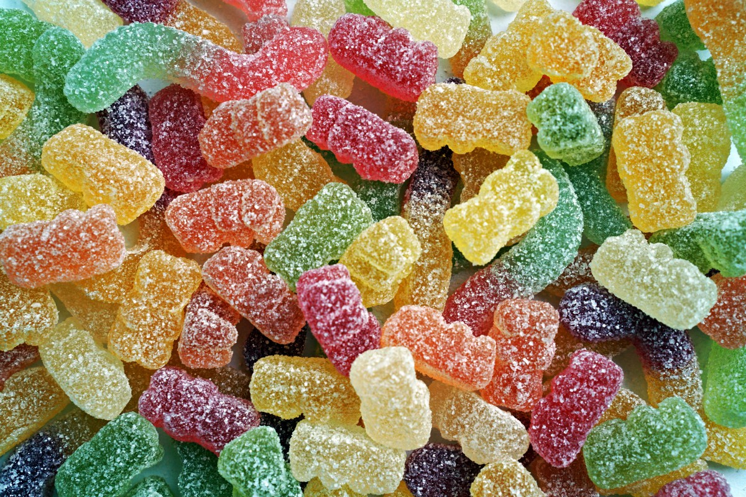
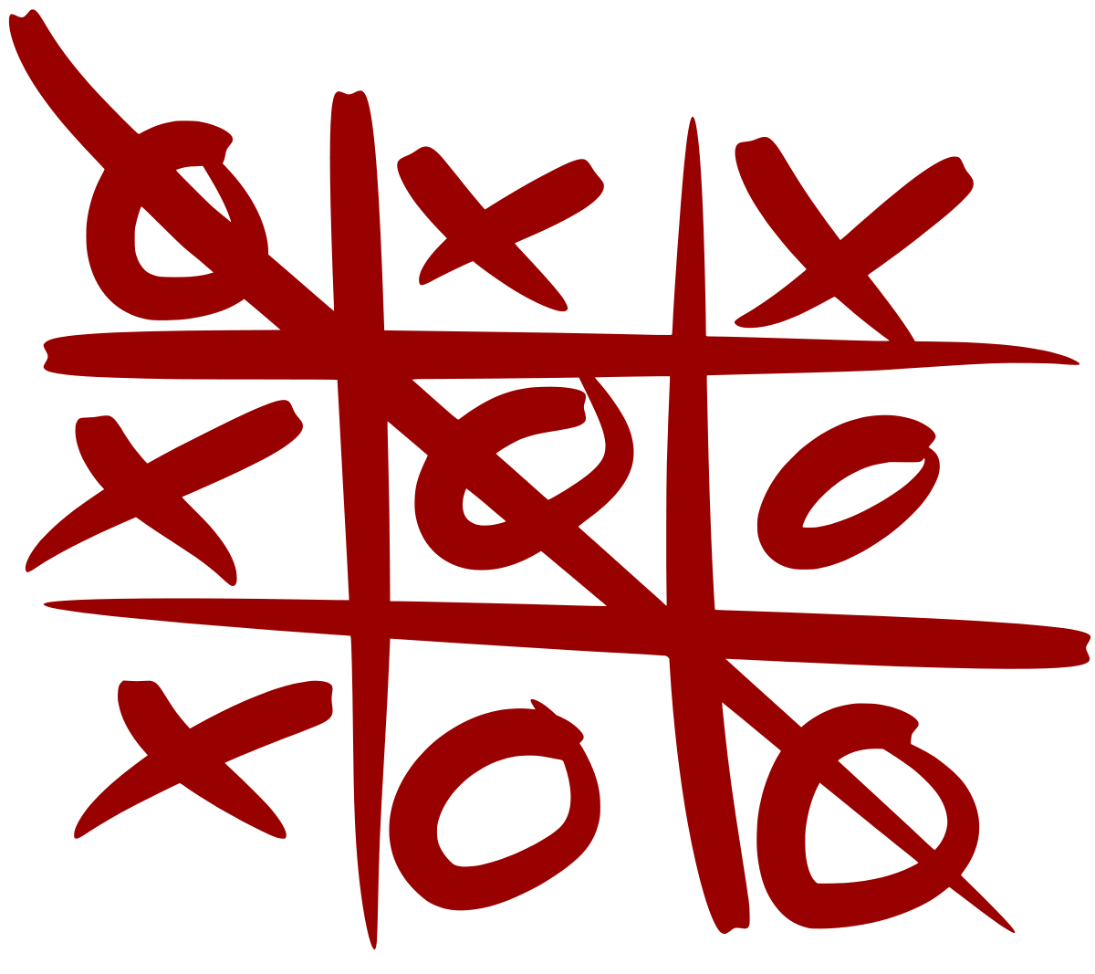

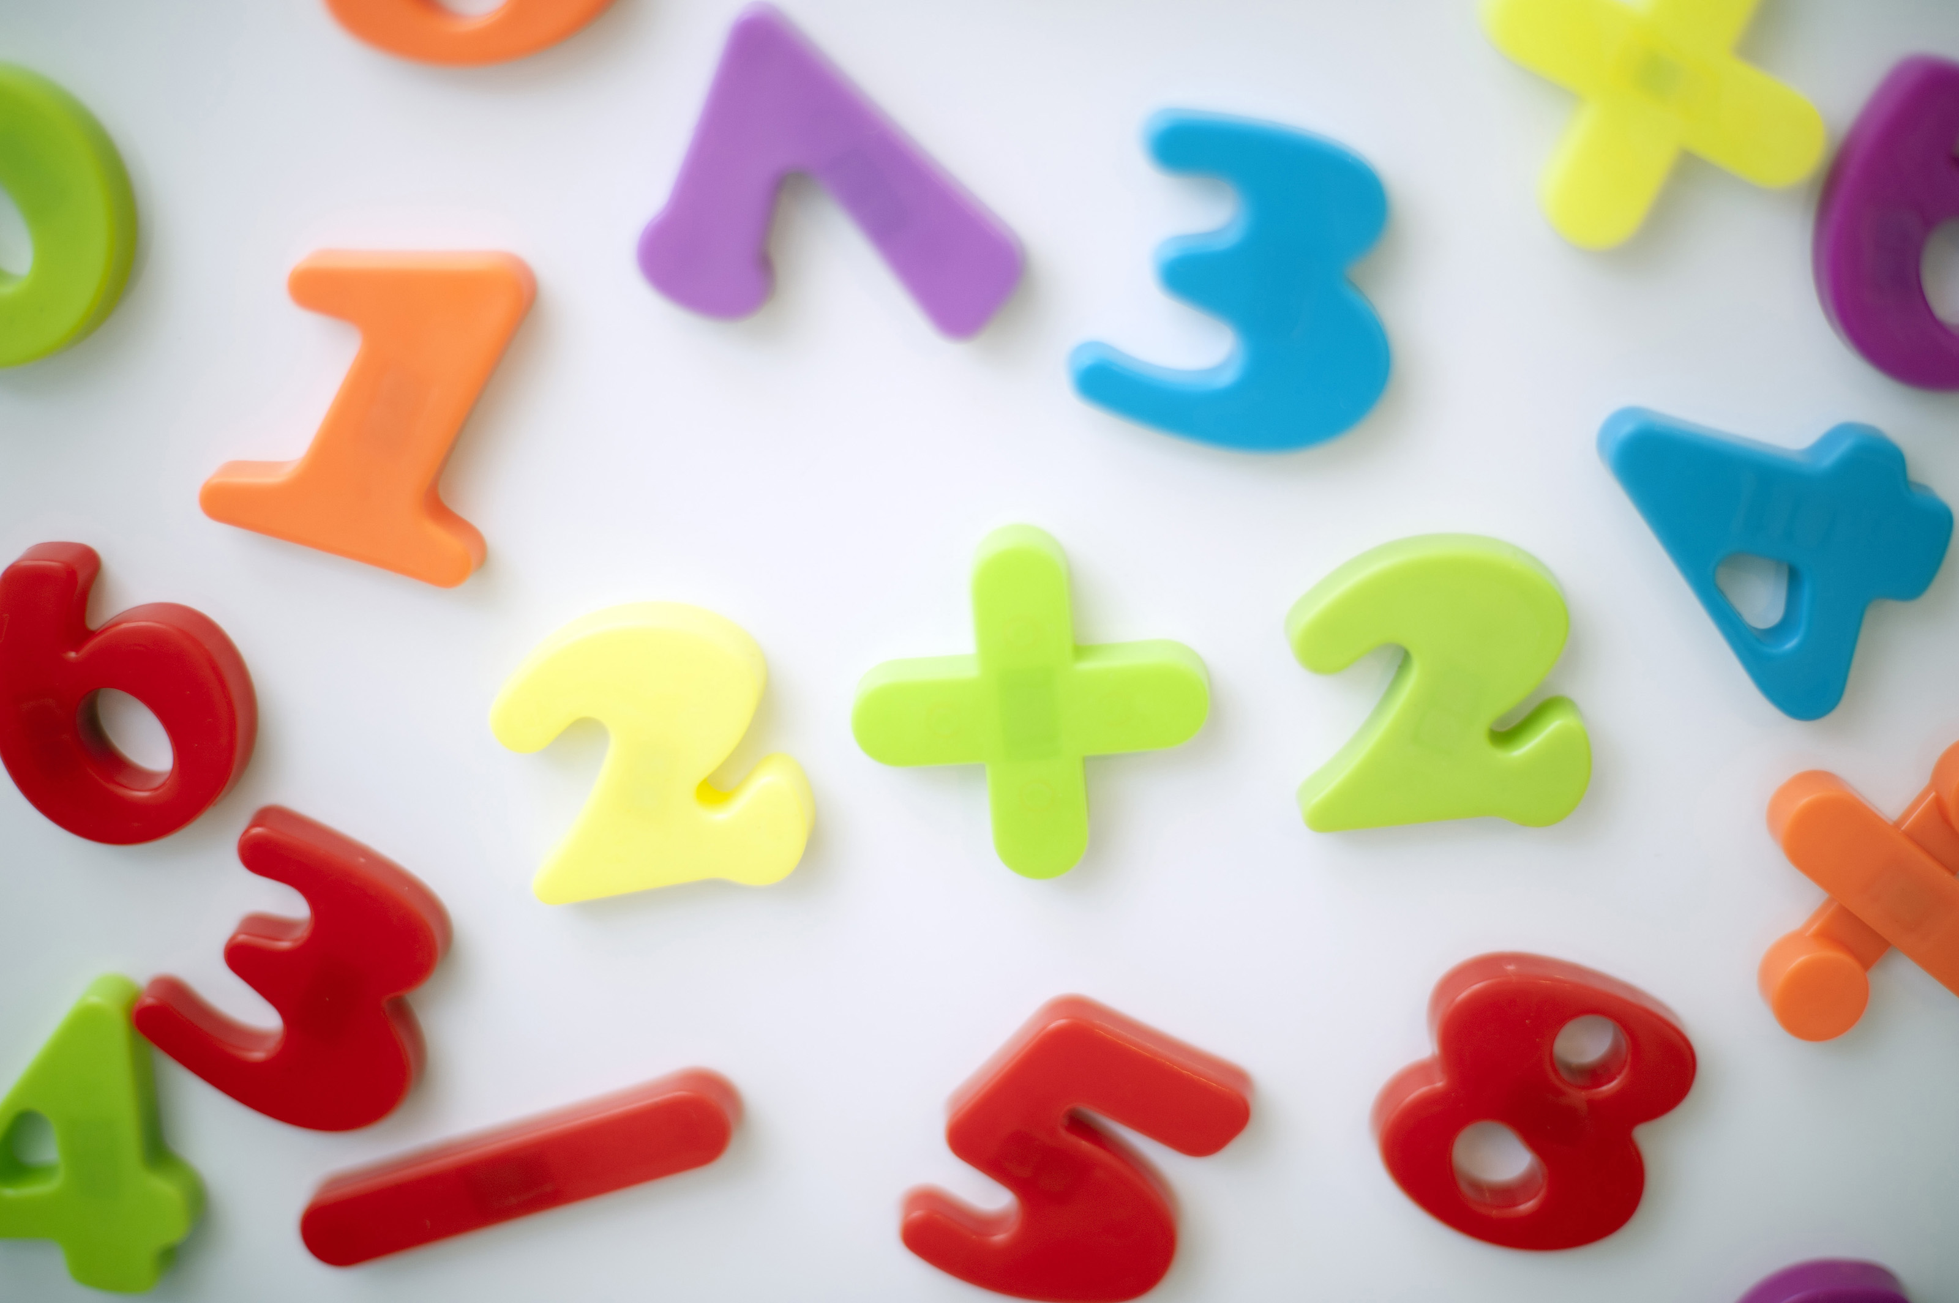


Sweets
Model this activity with one package of Skittles or M&Ms and a document camera, or let each student have his or her own package. Younger students can graph the contents of their packages by colour. Older students can calculate the ratio of each colour compared with the total number of pieces of candy in their packages.
Challenge: Compile the class results into one graph, then have each student compare his or her ratio to the ratio for the entire class.
Simon says
Use this traditional game but say “Simon says...fractions” children then respond with anything related to that maths topic. This could be the vocabulary used etc.
Tic Tac Toe
Draw a noughts and crosses grid, one player has odd numbers and one has even numbers. The aim is to complete a row or column with a total of 15.
Try other totals.
Fizz Buzz
Children sit in circle and count from 1. Choose Fizz for multiples of a number and buzz for multiples of another. If a multiple of both the numbers chosen appears the children must say Fizz Buzz.
Try changing the multiples for different games.
Match it
Children sit so they can all see each other. They each need a whiteboard and a pen. They write a calculation on the whiteboard which has an answer between 0-30. They then need to find someone whose calculation equals the same number theirs does.
What’s my number?
One child chooses a number between 0 and 100. Children then ask questions to establish what that number is.

Slide 3
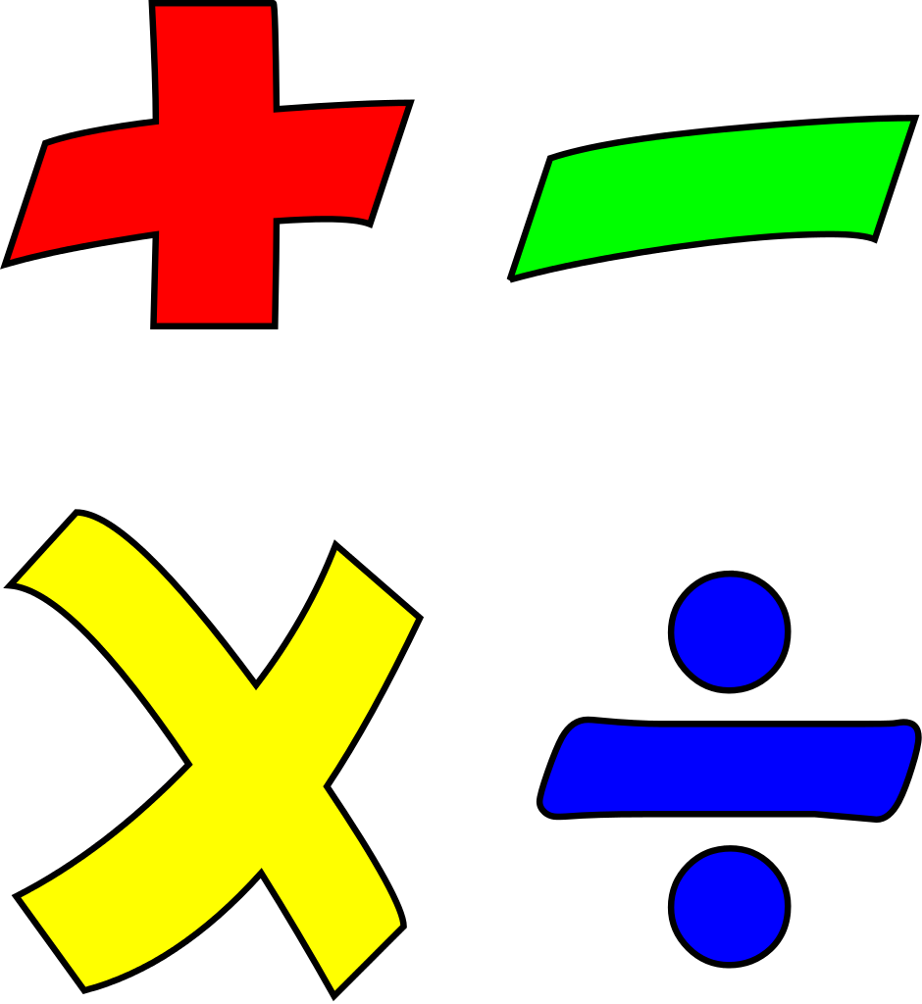
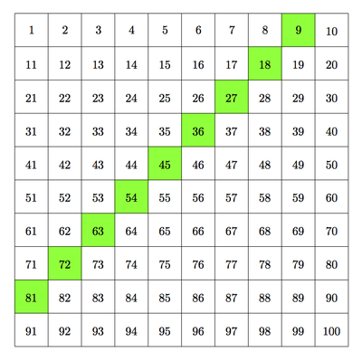
What sign/method am I?
Choose a method you want to be, for example “subtraction”, use different language to explain it without saying the word subtraction…difference, we used the subtrahend etc. The children need to guess what sign you are.
Count in multiples.
Count-up as a class in multiples of a number. 7, 14, 21, 28 etc. The class go round in a circle and each person needs to say the next number in the sequence.

