Slide 1



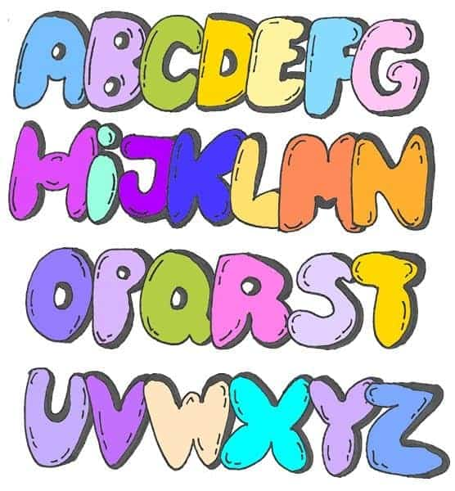


Bubble words:
Write your spellings in bubble letters. You can colour these in afterwards.
Spelling flowers:
Draw a big flower. Write each of your spelling words on one of the petals.
Write your spelling words using dots. Connect the dots you’ve drawn by tracing over them with a coloured pencil.
This Photo by Unknown Author is licensed under CC BY-SA

Slide 2



Fancy letters:
Write out your spellings in fancy handwriting and take your time.
Silly sentences!
Write silly sentences that include your spellings in. How many of your spellings can you fit into one sentence?
Rainbow write:
First write your spelling words in pencil then trace over the words five times using a different colour each time.

Slide 3

Tell a story:
Write a short story using your spelling words and underline them when you use them!

Slide 4
________________________________________________________________________________________________________________________________________________________________________________________________________________________________________________________________________________________________________________________________________________________________________________________________________________________________________________________________________________________________________________________________________________________________________________________________________________________________________________________________________________________________________________________________________________________________________________________________________
Write your own sentences using: 1-eight, 2-eighth, 3-enough, 4-exercise
________________________________________________________________________________________________________________________________________________________________________________________________________________________________________________________________________________________________________________________________________________________________________________________________________________________________________________________________________________________________________________________________________________________________________________________________________________________________________________________________________________________________________________________________________________________________________________________________________
Write your own sentences using: 1-experience, 2-experiment, 3-famous 4-extreme

Slide 5
________________________________________________________________________________________________________________________________________________________________________________________________________________________________________________________________________________________________________________________________________________________________________________________________________________________________________________________________________________________________________________________________________________________________________________________________________________________________________________________________________________________________________________________________________________________________________________________________________
Write your own sentences using: 1-believe, 2-bicycle, 3-breath, 4-breathe
________________________________________________________________________________________________________________________________________________________________________________________________________________________________________________________________________________________________________________________________________________________________________________________________________________________________________________________________________________________________________________________________________________________________________________________________________________________________________________________________________________________________________________________________________________________________________________________________________
Write your own sentences using: 1-build, 2-busy, 3-business, 4-calendar

Slide 6
________________________________________________________________________________________________________________________________________________________________________________________________________________________________________________________________________________________________________________________________________________________________________________________________________________________________________________________________________________________________________________________________________________________________________________________________________________________________________________________________________________________________________________________________________________________________________________________________________
Write your own sentences using: 1-caught, 2-centre, 3-century, 4-certain
________________________________________________________________________________________________________________________________________________________________________________________________________________________________________________________________________________________________________________________________________________________________________________________________________________________________________________________________________________________________________________________________________________________________________________________________________________________________________________________________________________________________________________________________________________________________________________________________________
Write your own sentences using: 1-circle, 2-complete, 3-consider, 4-continue

Slide 7
________________________________________________________________________________________________________________________________________________________________________________________________________________________________________________________________________________________________________________________________________________________________________________________________________________________________________________________________________________________________________________________________________________________________________________________________________________________________________________________________________________________________________________________________________________________________________________________________________
Write your own sentences using: 1-decide, 2-describe, 3-describe, 4-different
________________________________________________________________________________________________________________________________________________________________________________________________________________________________________________________________________________________________________________________________________________________________________________________________________________________________________________________________________________________________________________________________________________________________________________________________________________________________________________________________________________________________________________________________________________________________________________________________________
Write your own sentences using: 1-difficult, 2-disappear, 3-early, 4-earth

Slide 8
________________________________________________________________________________________________________________________________________________________________________________________________________________________________________________________________________________________________________________________________________________________________________________________________________________________________________________________________________________________________________________________________________________________________________________________________________________________________________________________________________________________________________________________________________________________________________________________________________
Write your own sentences using: 1-accident, 2- actual, 3-answer, 4- arrive
________________________________________________________________________________________________________________________________________________________________________________________________________________________________________________________________________________________________________________________________________________________________________________________________________________________________________________________________________________________________________________________________________________________________________________________________________________________________________________________________________________________________________________________________________________________________________________________________________
Write your own sentences using: 1-accidentally, 2-actually, 3-address, 4- appear

Slide 9
________________________________________________________________________________________________________________________________________________________________________________________________________________________________________________________________________________________________________________________________________________________________________________________________________________________________________________________________________________________________________________________________________________________________________________________________________________________________________________________________________________________________________________________________________________________________________________________________________
Write your own sentences using: 1-favourite, 2- February, 3-forward, 4- forwards
________________________________________________________________________________________________________________________________________________________________________________________________________________________________________________________________________________________________________________________________________________________________________________________________________________________________________________________________________________________________________________________________________________________________________________________________________________________________________________________________________________________________________________________________________________________________________________________________________
Write your own sentences using: 1-guard, 2-group, 3-grammar, 4-fruit

Slide 10
________________________________________________________________________________________________________________________________________________________________________________________________________________________________________________________________________________________________________________________________________________________________________________________________________________________________________________________________________________________________________________________________________________________________________________________________________________________________________________________________________________________________________________________________________________________________________________________________________
Write your own sentences using: 1-guide, 2-heard, 3-heart, 4-height
________________________________________________________________________________________________________________________________________________________________________________________________________________________________________________________________________________________________________________________________________________________________________________________________________________________________________________________________________________________________________________________________________________________________________________________________________________________________________________________________________________________________________________________________________________________________________________________________________
Write your own sentences using: 1-important, 2-increase, 3-imagine, 4-history

Slide 11
________________________________________________________________________________________________________________________________________________________________________________________________________________________________________________________________________________________________________________________________________________________________________________________________________________________________________________________________________________________________________________________________________________________________________________________________________________________________________________________________________________________________________________________________________________________________________________________________________
Write your own sentences using: 1-interest, 2-island, 3-knowledge, 4-learn
________________________________________________________________________________________________________________________________________________________________________________________________________________________________________________________________________________________________________________________________________________________________________________________________________________________________________________________________________________________________________________________________________________________________________________________________________________________________________________________________________________________________________________________________________________________________________________________________________
Write your own sentences using: 1-medicine, 2-material, 3-library, 4-length

Slide 12
________________________________________________________________________________________________________________________________________________________________________________________________________________________________________________________________________________________________________________________________________________________________________________________________________________________________________________________________________________________________________________________________________________________________________________________________________________________________________________________________________________________________________________________________________________________________________________________________________
Write your own sentences using: 1-mention, 2-minute, 3-natural, 4-naughty
________________________________________________________________________________________________________________________________________________________________________________________________________________________________________________________________________________________________________________________________________________________________________________________________________________________________________________________________________________________________________________________________________________________________________________________________________________________________________________________________________________________________________________________________________________________________________________________________________
Write your own sentences using: 1-often, 2-occasionally, 3-occasion, 4-notice

Slide 13
________________________________________________________________________________________________________________________________________________________________________________________________________________________________________________________________________________________________________________________________________________________________________________________________________________________________________________________________________________________________________________________________________________________________________________________________________________________________________________________________________________________________________________________________________________________________________________________________________
Write your own sentences using: 1-opposite, 2-ordinary, 3-particular, 4-perculiar
________________________________________________________________________________________________________________________________________________________________________________________________________________________________________________________________________________________________________________________________________________________________________________________________________________________________________________________________________________________________________________________________________________________________________________________________________________________________________________________________________________________________________________________________________________________________________________________________________
Write your own sentences using: 1-possess, 2-position, 3-popular, 4-perhaps

Slide 14
________________________________________________________________________________________________________________________________________________________________________________________________________________________________________________________________________________________________________________________________________________________________________________________________________________________________________________________________________________________________________________________________________________________________________________________________________________________________________________________________________________________________________________________________________________________________________________________________________
Write your own sentences using: 1-possession, 2-possible, 3-potatoes, 4-pressure
________________________________________________________________________________________________________________________________________________________________________________________________________________________________________________________________________________________________________________________________________________________________________________________________________________________________________________________________________________________________________________________________________________________________________________________________________________________________________________________________________________________________________________________________________________________________________________________________________
Write your own sentences using: 1-quarter, 2-purpose, 3-promise, 4-probably

Slide 15
________________________________________________________________________________________________________________________________________________________________________________________________________________________________________________________________________________________________________________________________________________________________________________________________________________________________________________________________________________________________________________________________________________________________________________________________________________________________________________________________________________________________________________________________________________________________________________________________________
Write your own sentences using: 1-question, 2-recent, 3-regular, 4-reign
________________________________________________________________________________________________________________________________________________________________________________________________________________________________________________________________________________________________________________________________________________________________________________________________________________________________________________________________________________________________________________________________________________________________________________________________________________________________________________________________________________________________________________________________________________________________________________________________________
Write your own sentences using: 1-special, 2-separate, 3-sentence, 4-remember

Slide 16
________________________________________________________________________________________________________________________________________________________________________________________________________________________________________________________________________________________________________________________________________________________________________________________________________________________________________________________________________________________________________________________________________________________________________________________________________________________________________________________________________________________________________________________________________________________________________________________________________
Write your own sentences using: 1-straight, 2-strange, 3-strength, 4-suppose
________________________________________________________________________________________________________________________________________________________________________________________________________________________________________________________________________________________________________________________________________________________________________________________________________________________________________________________________________________________________________________________________________________________________________________________________________________________________________________________________________________________________________________________________________________________________________________________________________
Write your own sentences using: 1-although, 2-though, 3-therefore, 4-surprise

Slide 17
________________________________________________________________________________________________________________________________________________________________________________________________________________________________________________________________________________________________________________________________________________________________________________________________________________________________________________________________________________________________________________________________________________________________________________________________________________________________________________________________________________________________________________________________________________________________________________________________________
Write your own sentences using: 1-thought, 2-through, 3-various, 4-weight
________________________________________________________________________________________________________________________________________________________________________________________________________________________________________________________________________________________________________________________________________________________________________________________________________________________________________________________________________________________________________________________________________________________________________________________________________________________________________________________________________________________________________________________________________________________________________________________________________
Write your own sentences using: 1-woman, 2-women

Slide 18
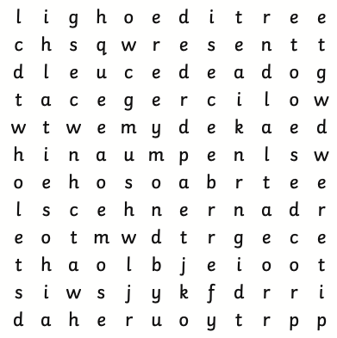
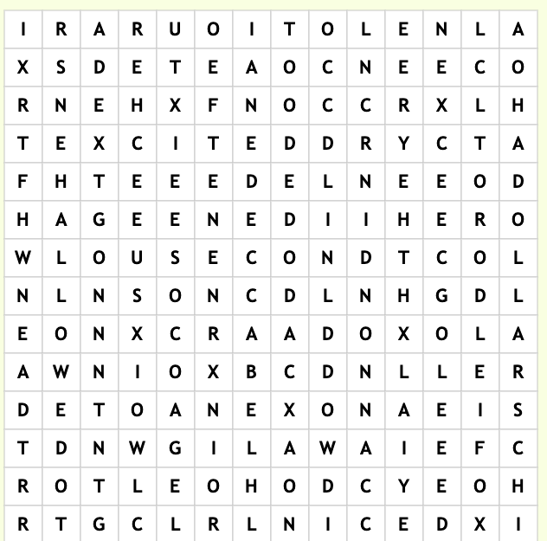
Wasn’t Whole
Watch Won’t
Weren’t You’re
We’re programme
Dollars Allowed They’re
Excited Brought Second
Field Cannon

Slide 19
Wasn’t Whole
Watch Won’t
Weren’t You’re
We’re programme
Dollars Allowed They’re
Excited Brought Second
Field Cannon

