Slide 1
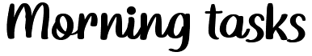

Slide 2

Write down as many different types of calculations which give the answer 47.
(Try to be as inventive as you can be!)

Slide 3

Write as many adverbs as possible to describe this verb:
Played

Slide 4
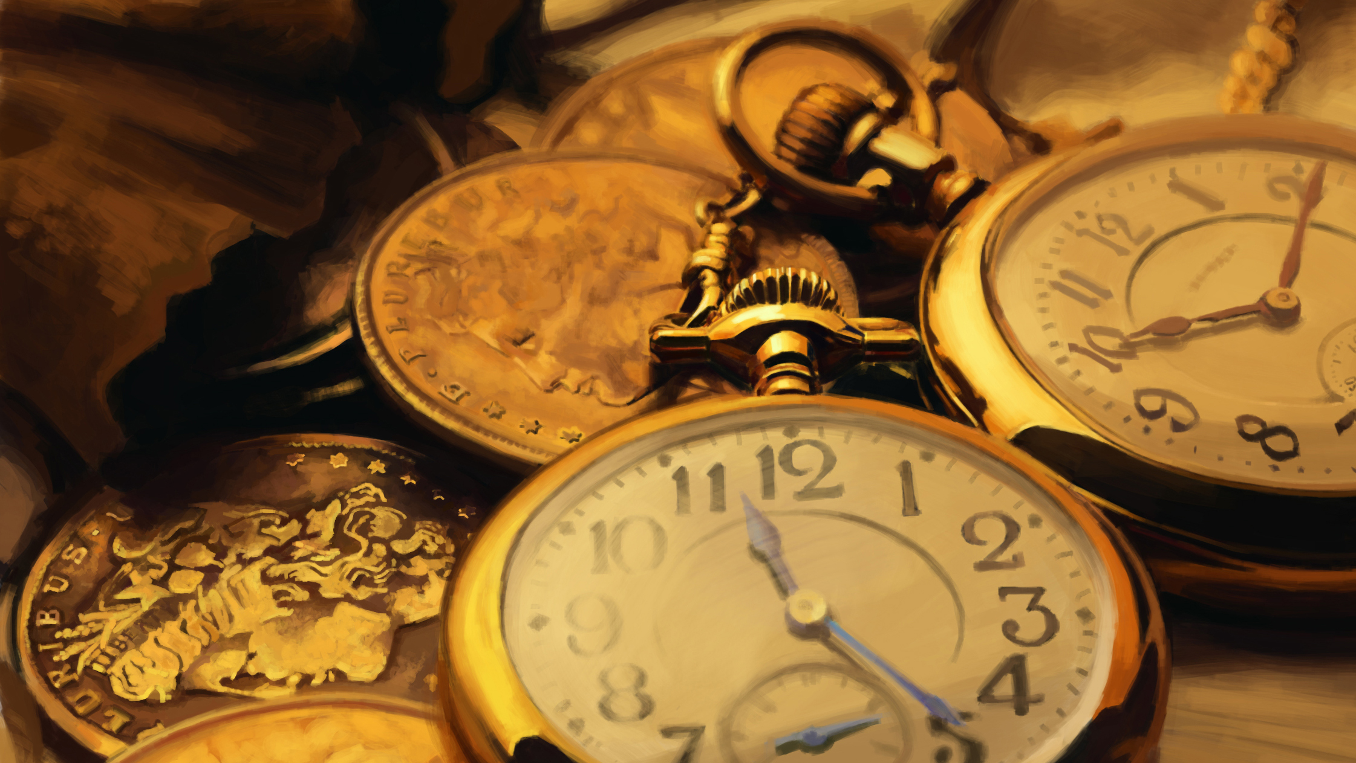
You arrive into the classroom to find it is the year 2099, what is different?

Slide 5

Write down the person that inspires you most, why?

Slide 6
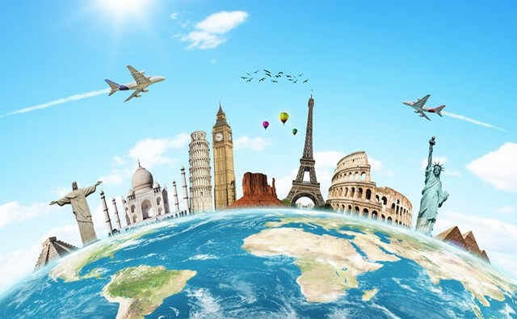
If you could visit somewhere else in the world, where would you go and why?

Slide 7
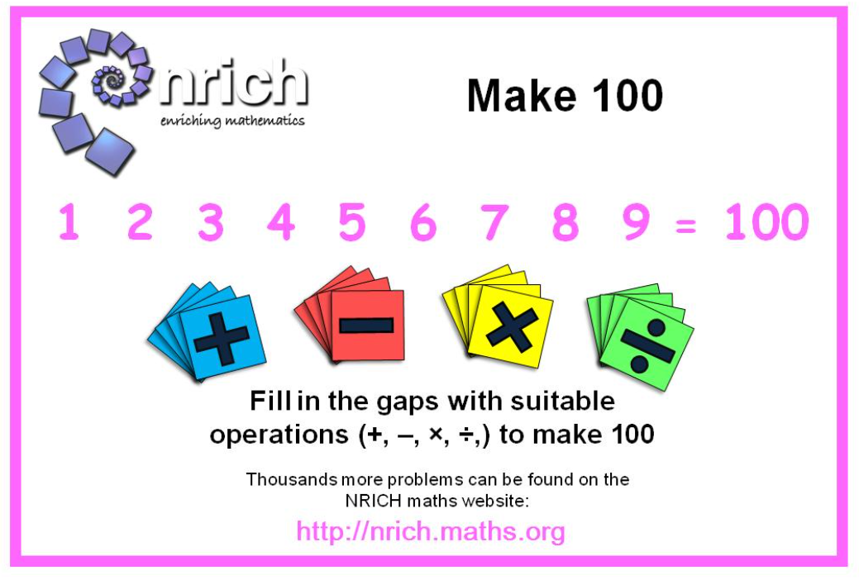
Complete the problem-solving task!

Slide 8


Which celebrity would you like teaching your English lesson and why?

Slide 9

Think of a book you have enjoyed recently. Design a book cover for this book!

Slide 10
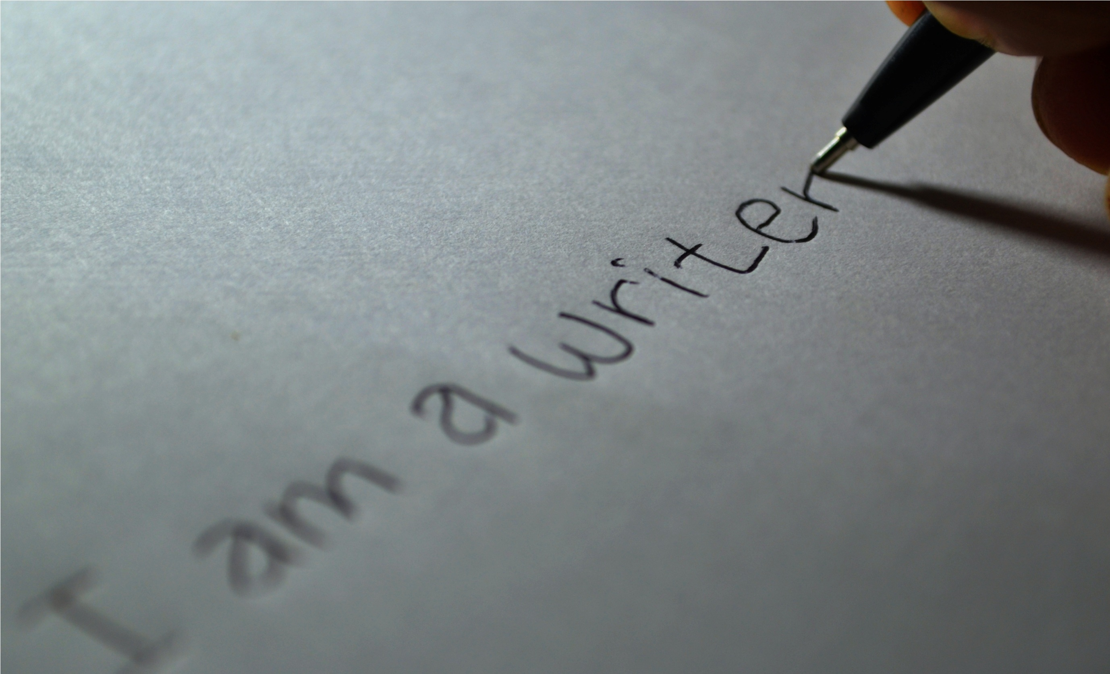
Write at least 3 sentences using the punctuation below:
“ ” , . ? !

Slide 11
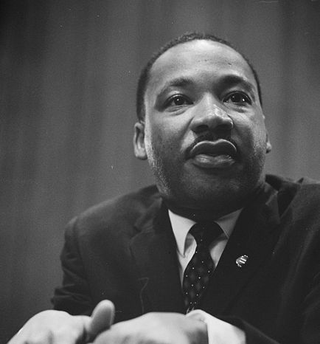
You walk into class and Martin Luther King JR is sitting in my chair.
What three questions would you ask him?

Slide 12

If you paint over a window, is it still a window?

Slide 13


Is there more future or more past?

Slide 14
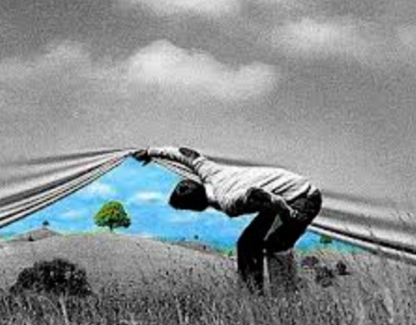
Write a 10 word story about the picture on the screen.

Slide 15
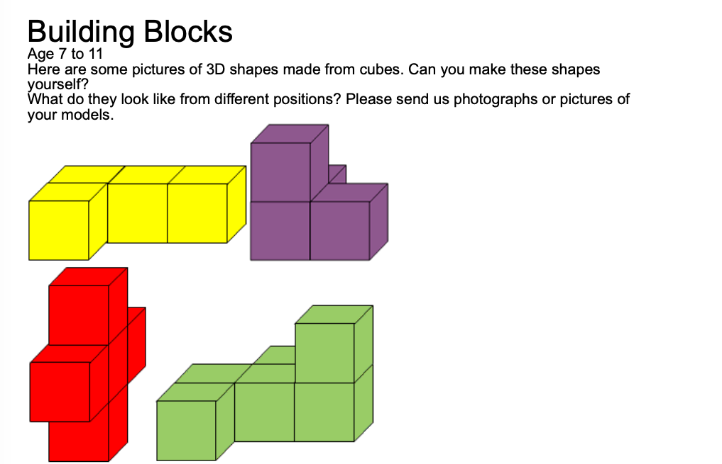
Complete the problem on the screen using your resources.

Slide 16
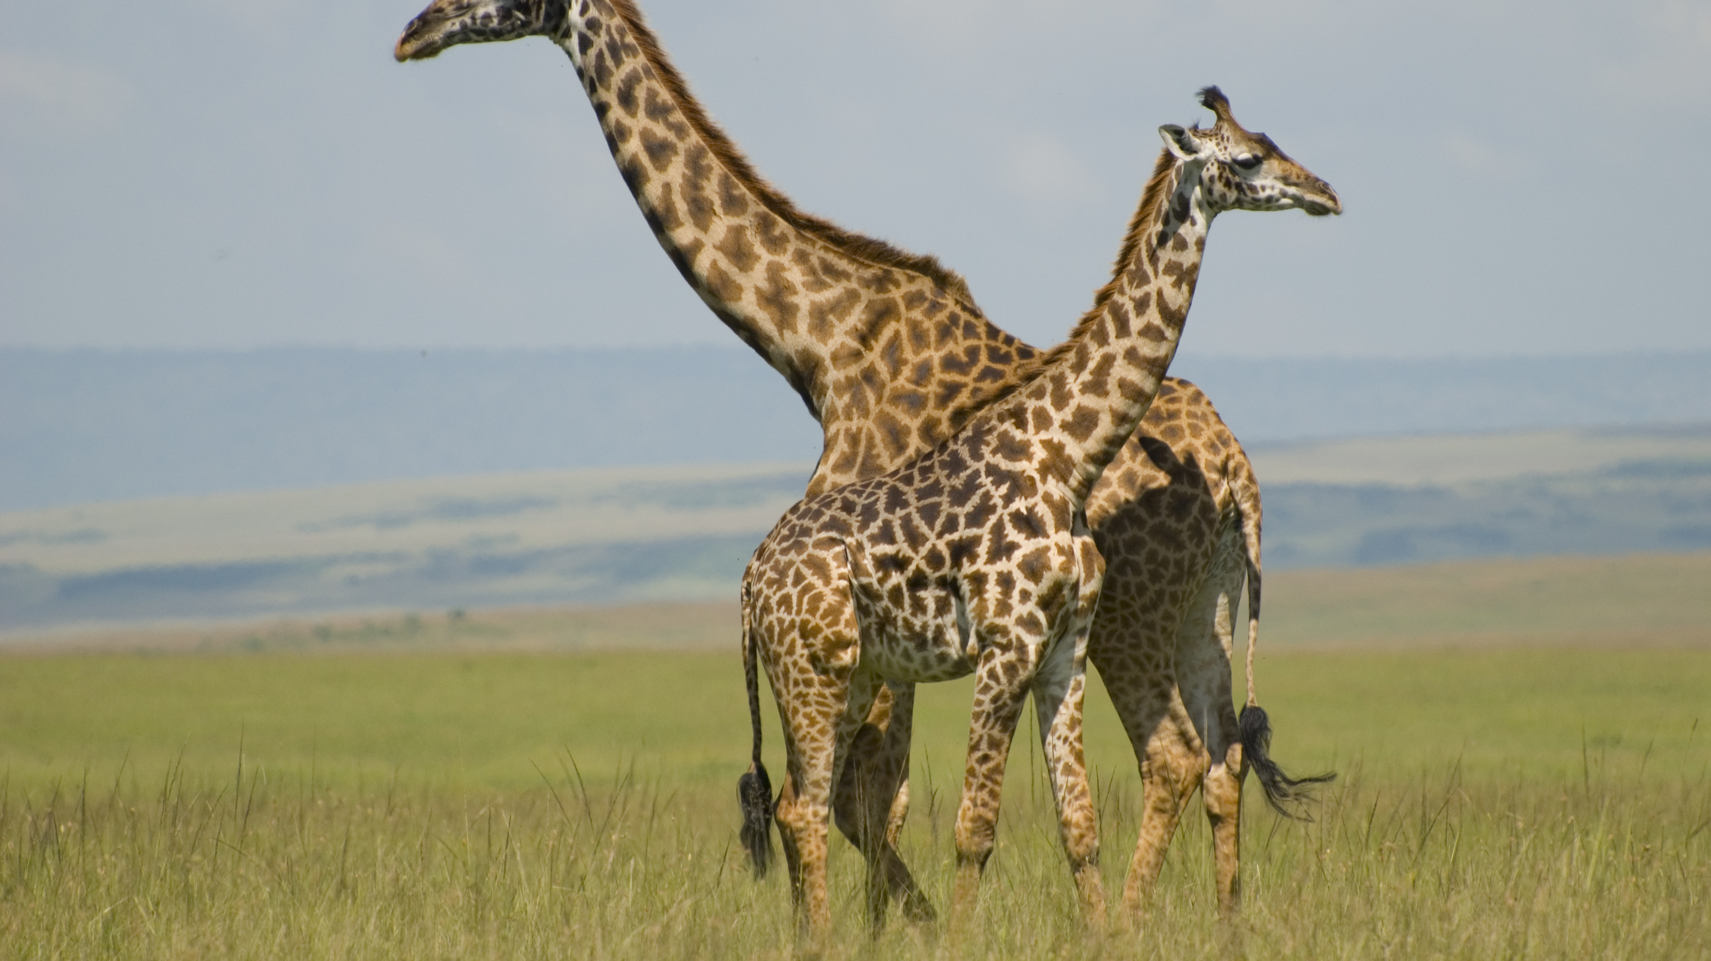
How would you describe a giraffe to someone who has never seen a picture of one before?

Slide 17

Where do words go once you’ve heard them?

Slide 18
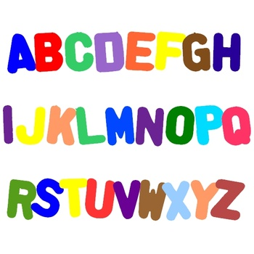
Write down a food item for every letter of the alphabet!

Slide 19
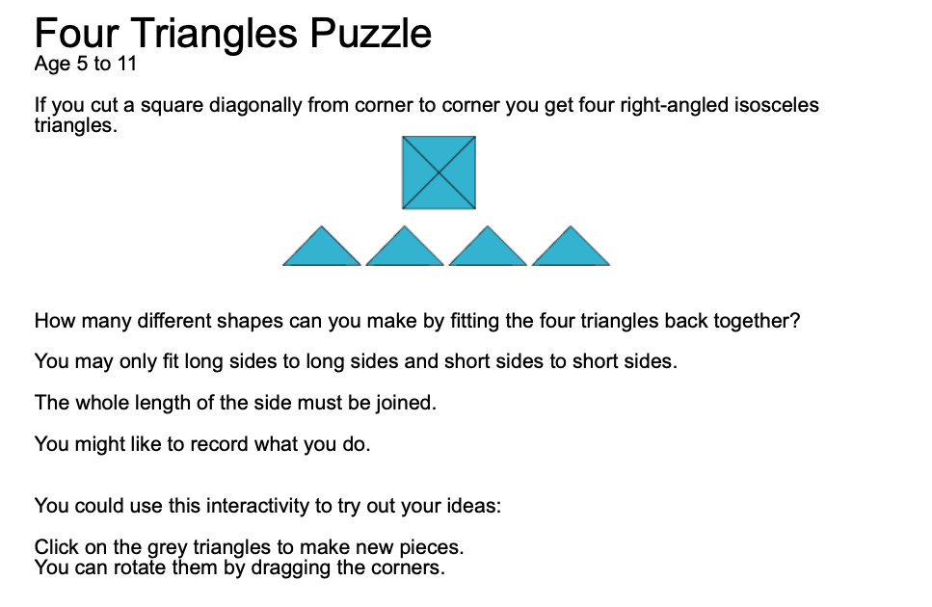
Complete the problem on the slide using the resources in front of you.

Slide 20

What do you want to learn/improve on over the next week?
Write 3 things down and explain how you will try and achieve them ☺

Slide 21

Would you rather have a camera as eyes or a voice recorder for ears?

Slide 22

Pick 3 of the word below and use them to make a WOW sentence!
Amazing Towards Ambitious Sensible
Astonishing Stupendous Delighted Ecstatic

Slide 23

Which connective could be used for each sentence:
Ben went to the doctor_______he was feeling ill.
Her face turned red________she was embarrassed.
Ellie was happy, _________feeling tears in her eyes.
This Photo by Unknown Author is licensed under CC BY-NC-ND

Slide 24

Write down the omitted letters for each word.
Don’t
Haven’t
Can’t
I’ll
We’re
We’ll
Won’t
She’s
They’re
Shouldn’t

Slide 25
Have the apostrophes been used for omission or possession? Write o or p for each sentence.
The girl’s bag is heavy.
I wouldn’t go in there if I were you.
She wanted to see Billy’s new book.
The frogs were croaking in Ben’s face.
I’m going to get you!
I couldn’t find the peg.
She’d like to meet you.
Can I see Sarah’s homework please?
I can’t do it!
Sally’s hair is the prettiest.

Slide 26
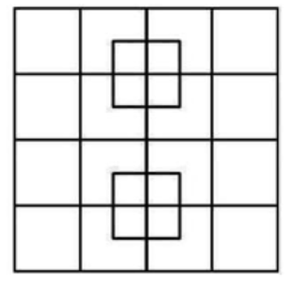
How many squares in the picture?

